Slide 1
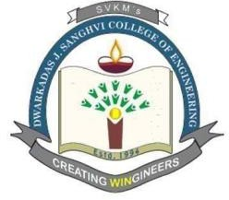
Final Year Project - Topic Presentation
Atharva Rajmane
60003210086
Vedant Kesharia
60003210085
Smit Shah
60003210180
Under the guidance of
Dr.Vinaya Sawant
Project Guide
Department of Information Technology
DJSCE
Mumbai University
2024-25

Slide 2

Name of the project/Thesis
Resource-Aware Scheduling Algorithms For Distributed Machine Learning in Heterogeneous Environments
Problem Definition
Literature Review(Observation and Conclusion)
Observed Gaps in Existing Algorithm
Proposed Solutions
Expected Improvements
Dept. of Information Technology
D.J.Sanghvi College of Engineering
‹#›

Slide 3
Name of the project/Thesis
Problem Definition
In heterogeneous environments, resources such as CPUs, GPUs, and memory vary significantly in terms of their capabilities and performance. Efficiently utilizing these diverse resources is challenging because traditional scheduling algorithms are often designed for homogeneous environments.
Dept. of Information Technology
D.J.Sanghvi College of Engineering
‹#›

Slide 4
Name of the project/Thesis
Problem Definition
This project aims to enhance the efficiency and effectiveness of distributed machine learning by developing resource-aware scheduling algorithms. Our objective is to address the limitations of existing algorithms that often overlook the diverse capabilities and constraints of heterogeneous systems.Current scheduling algorithms lead to suboptimal performance and resource wastage due to their inability to adapt to the varying characteristics of different hardware and software environments. This project investigates these inefficiencies and proposes innovative scheduling strategies designed specifically for heterogeneous settings.The proposed algorithms will be evaluated on their ability to dynamically adjust to resource availability, reduce computational overhead, and improve overall system performance. Key features include adaptive resource allocation, real-time performance monitoring, and scalability across various machine learning frameworks and hardware configurations.
Dept. of Information Technology
D.J.Sanghvi College of Engineering
‹#›

Slide 5
Name of the project/Thesis
Definition of Heterogenous Environment
A heterogeneous environment in distributed machine learning refers to a network of interconnected nodes participating in a load-sharing architecture, where each node possesses a distinct combination of fixed and optional resources (such as CPUs, GPUs, and memory). These resources may vary significantly between nodes, leading to differing computational capabilities, which need to be accounted for in task scheduling and resource allocation.
Dept. of Information Technology
D.J.Sanghvi College of Engineering
‹#›

Slide 6
Name of the project/Thesis
Node Structure
Each node will be described with the following attributes:
node_id: Unique identifier for each node.
resources: Fixed resources for each node, including:
CPU: The type, number of cores, and clock speed.
GPU: Optional; includes type, memory size, and number of GPUs.
RAM_GB: Total RAM.
Storage: Type (SSD/HDD) and capacity.
optional_resources: Includes resources that may not be present in all nodes, like network bandwidth or TPUs
Dept. of Information Technology
D.J.Sanghvi College of Engineering
‹#›

Slide 7
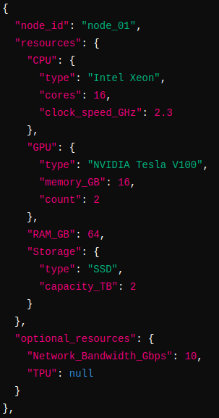
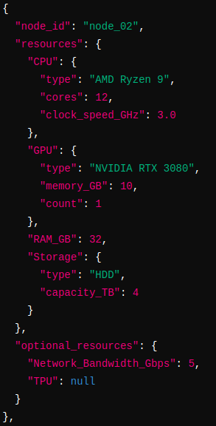
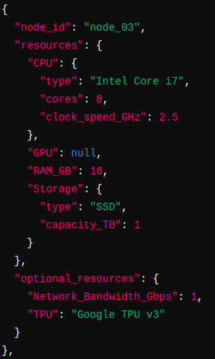
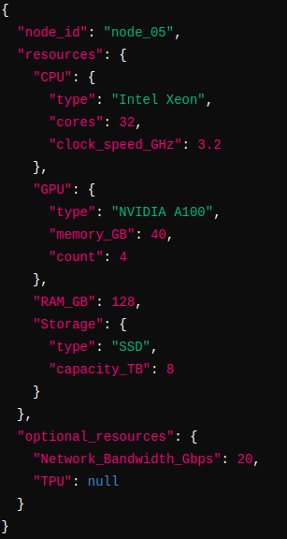
Name of the project/Thesis
Examples
Dept. of Information Technology
D.J.Sanghvi College of Engineering
‹#›

Slide 8
Name of the project/Thesis
Literature Survey(Existing Algorithm)
“Learning scheduling algorithms for data processing clusters.” Mao, H., Schwarzkopf, M., Venkatakrishnan, S. B., Meng, Z., & Alizadeh, M. (2019).
Summary: This paper explores the use of machine learning to design scheduling algorithms for data processing clusters. The authors present a system called Decima, which uses reinforcement learning (RL) to learn and optimize scheduling policies automatically. Key contributions include:
Reinforcement Learning for Scheduling: Decima uses RL to autonomously learn the best way to allocate resources for jobs represented as directed acyclic graphs (DAGs). Each node in a DAG represents a task, and edges capture dependencies between tasks. The system optimizes the scheduling by learning from feedback (job completion times), rather than relying on static heuristics.
Scalable GNN Models: Decima employs GNNs to handle the complexity of the job's DAGs, enabling the scheduler to make decisions based on the structure of tasks and their dependencies, making it scalable to various job sizes and workflows.
Dealing with Stochastic Job Arrivals: A challenge for off-the-shelf RL techniques is handling the randomness in job arrivals. Decima integrates curriculum learning and variance reduction techniques to improve RL training and ensure the system is responsive to continuous job inflow, without requiring manual adjustments.
Dept. of Information Technology
D.J.Sanghvi College of Engineering
‹#›

Slide 9
Name of the project/Thesis
Literature Survey(Existing Algorithm)
“Dynamic resource allocation in cloud computing using a distributed scheduler.” Das D., Tiwari, A., & Agrawal, D. (2020).
Summary: This paper addresses the challenge of dynamic resource allocation in cloud computing environments by proposing a distributed scheduling approach. Key contributions and features include:
Distributed Scheduler: Developing a distributed scheduler that can make resource allocation decisions in a decentralized manner, improving scalability and fault tolerance.
Dynamic Resource Allocation: Introducing algorithms that dynamically allocate resources based on current demand and workload characteristics, ensuring efficient utilization of cloud resources.
Performance Evaluation: Providing extensive performance evaluations that show the proposed scheduler's effectiveness in improving resource utilization, reducing job waiting times, and enhancing overall system performance compared to traditional centralized approaches.
Dept. of Information Technology
D.J.Sanghvi College of Engineering
‹#›

Slide 10
Name of the project/Thesis
Literature Survey(Existing Algorithm)
“Scheduling and resource allocation for real-time streaming services in cloud computing.”Vasilakos, A. V., & Liu, M. (2016).
Summary: This paper focuses on the challenges of scheduling and resource allocation for real-time streaming services in cloud computing environments. The authors propose a comprehensive framework designed to meet the stringent requirements of real-time streaming applications. Key aspects include:
Real-Time Requirements: Addressing the specific needs of real-time streaming services, such as low latency and high availability, through optimized scheduling and resource allocation techniques.
Proposed Framework: Introducing a novel framework that combines both predictive and adaptive strategies to manage resources effectively, ensuring the timely processing and delivery of streaming data.
Algorithm Development: Developing algorithms that consider various factors, including network conditions, resource availability, and workload characteristics, to optimize the scheduling and allocation processes.
Dept. of Information Technology
D.J.Sanghvi College of Engineering
‹#›

Slide 11
Name of the project/Thesis
Literature Survey(Existing Algorithm)
“Deep Reinforcement Learning-based Methods for Resource Scheduling in Cloud Computing: A Review and Future Directions.”Guangyao Zhou, Wenhong Tian, Rajkumar Buyya (2021) .
The paper addresses the need for efficient resource scheduling in cloud computing environments, focusing on improving quality of service (QoS), reducing costs, and minimizing environmental impact. The authors highlight the challenges posed by the dynamic and complex nature of cloud systems.
The paper proposes a framework that leverages Deep Reinforcement Learning (DRL) to handle the complexities of resource scheduling. This framework combines deep learning and reinforcement learning to create a system capable of learning and adapting to changing conditions in real-time.
The paper develops algorithms that utilize DRL to optimize resource scheduling. These algorithms consider various factors such as network conditions, resource availability, and workload characteristics. By continuously learning from the environment, the DRL-based algorithms aim to make optimal scheduling decisions that enhance performance and efficiency
Dept. of Information Technology
D.J.Sanghvi College of Engineering
‹#›

Slide 12
Name of the project/Thesis
Literature Survey(Existing Algorithm)
“StraightLine: An End-to-End Resource-Aware Scheduler for Machine Learning Application Requests” by Cheng-Wei Ching, Boyuan Guan, Hailu Xu, and Liting Hu.
The algorithm in the paper addresses the need for efficient resource scheduling in hybrid infrastructures, which include cloud data centers, local servers, containers, and serverless platforms. It aims to reduce response time and failure rates for ML application requests.
The paper proposes the framework, named StraightLine, an end-to-end resource-aware scheduler that dynamically places ML application requests based on their unique characteristics, such as request frequency, input data size, and data distribution. It intelligently selects the optimal resources (e.g., container, virtual machine, or serverless process) for each request. Key components include:
Empirical Dynamic Placing Algorithm: This algorithm places requests by considering their specific characteristics and the available resources in the hybrid infrastructure.
Resource Optimization: The scheduler optimizes resource utilization by selecting the most suitable type of resource for each request, ensuring efficient processing and deployment.
Hybrid Infrastructure Support: The framework supports various types of computing resources, making it adaptable to different real-world scenarios.
Dept. of Information Technology
D.J.Sanghvi College of Engineering
‹#›

Slide 13
Name of the project/Thesis
Literature Survey(Existing Algorithm)
“Distributed ML Training on Android Devices.” Tanmai Kamat , Sarang Kadakia , Ayush Kapadia (Blackbook)
The algorithm is designed to leverage the computational power of smartphones for local ML training, reducing reliance on external servers and enhancing privacy. It addresses the need for efficient, decentralized processing and data sharing among devices.
The framework utilizes a Wi-Fi neighborhood sharing algorithm to distribute data across multiple Android devices. Each device trains a portion of the dataset using the MobileNet model, a convolutional neural network (CNN) optimized for mobile devices. This collaborative approach improves model accuracy by learning from diverse datasets.Key components include:
Distributed Training: Data is distributed across devices, each training a part of the dataset.
Wi-Fi Direct for Communication: Devices communicate in a peer-to-peer (P2P) network using the Wi-Fi Direct API, enabling direct data sharing without internet connectivity.
MobileNet for Image Classification: MobileNet architecture is used for efficient image classification on resource-constrained devices.
Dept. of Information Technology
D.J.Sanghvi College of Engineering
‹#›

Slide 14
Name of the project/Thesis
Literature Review(Observation and Conclusion)
Research Paper Title | Observation and Conclusion
1.“Learning scheduling algorithms for data processing clusters.” Mao, H., Schwarzkopf, M., Venkatakrishnan, S. B., Meng, Z., & Alizadeh, M. (2019). | traditional scheduling heuristics for data clusters are inefficient in handling complex, dynamic workloads with task dependencies. Decima, leveraging reinforcement learning (RL) and graph neural networks (GNNs), adapts to job-specific characteristics, resulting in better resource allocation and significantly reduced job completion times. In testing, Decima outperformed hand-tuned heuristics, reducing job latency by up to 2x during high-load periods.
2.“Dynamic resource allocation in cloud computing using a distributed scheduler.” Das D., Tiwari, A., & Agrawal, D. (2020). | The algorithm in the paper dynamically allocates cloud resources using a distributed scheduler, ensuring efficient load balancing and real-time adjustments based on resource usage. It aims to minimize task completion time and operational costs while maintaining fault tolerance. Overall, this approach enhances cloud performance and cost-efficiency, making it robust against varying workloads and potential node failures.
Dept. of Information Technology
D.J.Sanghvi College of Engineering
‹#›

Slide 15
Name of the project/Thesis
Literature Review(Observation and Conclusion)
Research Paper Title | Observation and Conclusion
3.“Scheduling and resource allocation for real-time streaming services in cloud computing.”Vasilakos, A. V., & Liu, M. (2016). | This paper address the challenges of scheduling and resource allocation for real-time streaming services in cloud computing. They observe that issues like latency, resource heterogeneity, and dynamic workload variations significantly impact performance. To tackle these, they propose a novel scheduling algorithm that enhances resource utilization and reduces latency. Their findings demonstrate that adaptive resource management strategies can improve the quality of service for real-time applications, making cloud environments more efficient and reliable.
4.“Deep Reinforcement Learning-based Methods for Resource Scheduling in Cloud Computing: A Review and Future Directions.”Guangyao Zhou, Wenhong Tian, Rajkumar Buyya (2021) . | The author address the use of deep reinforcement learning (DRL) for resource scheduling in cloud computing. They observe that traditional methods struggle with the complexity and dynamic nature of cloud environments, while DRL shows significant promise in improving resource allocation and system performance. The authors conclude that DRL-based methods can effectively enhance the efficiency and adaptability of resource scheduling, highlighting the potential for future research to refine these methods and address existing challenges, leading to more robust and scalable cloud systems.
Dept. of Information Technology
D.J.Sanghvi College of Engineering
‹#›

Slide 16
Name of the project/Thesis
Literature Review(Observation and Conclusion)
Research Paper Title | Observation and Conclusion
5.“Scheduling and resource allocation for real-time streaming services in cloud computing.”Vasilakos, A. V., & Liu, M. (2016). | This paper address the challenges of scheduling and resource allocation for real-time streaming services in cloud computing. They observe that latency, resource heterogeneity, and dynamic workload variations significantly affect performance. To address these issues, they propose a novel scheduling algorithm that enhances resource utilization and reduces latency. Their findings suggest that adaptive resource management strategies can improve the efficiency and reliability of real-time applications in cloud environments.
6.“Distributed ML Training on Android Devices.” Tanmai Kamat , Sarang Kadakia , Ayush Kapadia (2023) (Blackbook) | The author address the burgeoning demand for adaptable AI solutions in everyday life. By harnessing the latent power of Android devices, this decentralized approach not only bridges the gap between evolving AI needs and daily requirements but also enhances accessibility, privacy, and user experience. The multifaceted methodology, powered by cutting-edge tech stacks, not only enables on-device ML training but also optimizes resources for model refinement without relying on external servers or cloud platforms. This transformative solution stands as a beacon for revolutionizing AI accessibility and efficiency, emphasizing its profound impact on reshaping the landscape of AI integration into our lives.
Dept. of Information Technology
D.J.Sanghvi College of Engineering
‹#›

Slide 17
Name of the project/Thesis
References
“Learning scheduling algorithms for data processing clusters.” Mao, H., Schwarzkopf, M., Venkatakrishnan, S. B., Meng, Z., & Alizadeh, M. (2019).
“Dynamic resource allocation in cloud computing using a distributed scheduler.” Das D., Tiwari, A., & Agrawal, D. (2020).
“Scheduling and resource allocation for real-time streaming services in cloud computing.”Vasilakos, A. V., & Liu, M. (2016).
“Deep Reinforcement Learning-based Methods for Resource Scheduling in Cloud Computing: A Review and Future Directions.”Guangyao Zhou, Wenhong Tian, Rajkumar Buyya (2021) .
“Scheduling and resource allocation for real-time streaming services in cloud computing.”Vasilakos, A. V., & Liu, M. (2016).
“Distributed ML Training on Android Devices.” Tanmai Kamat , Sarang Kadakia , Ayush Kapadia (2023) (Blackbook)
Dept. of Information Technology
D.J.Sanghvi College of Engineering
‹#›

Slide 18
Name of the project/Thesis
Thank You!!!
Dept. of Information Technology
D.J.Sanghvi College of Engineering
‹#›

